Slide 1
Performance Optimization Techniques for System Design

Slide 2
Performance Optimization
Designing systems that are efficient, scalable, and high-performing is crucial in modern applications.
As systems handle more users and data, optimization becomes important to maintain speed, reliability, and smooth user experience.
Improves system performance and reduces response time by distributing workloads efficiently.
Ensures scalability and better resource utilization while handling increasing users and data.

Slide 3
Example
In an e-commerce website, optimizing database queries and using caching helps load product pages faster, even during high traffic like a sale.

Slide 4
Performance Optimization Techniques for System Design
Data Structures & Algorithms
Caching
Database Optimizations
Scalability & Load Balancing
Microservices & Architectural Patterns
Network Optimization

Slide 5
Partitioning strategies in spark
Control how data is divided across cluster nodes to maximize parallelism, minimize network shuffling, and optimize memory usage.

Slide 6
Core Memory Partitioning Strategies
Hash Partitioning (Default): Applies a hash function to record keys to distribute rows across partitions. Works well when keys are uniformly distributed, but can cause severe data skew if certain keys appear much more often than others.
Range Partitioning: Sorts data by a range of keys so that items with similar values land in the same partition. Useful for maintaining ordered data and optimizing range-based queries or sorting operations.

Slide 7
In-Memory Transformation Methods
repartition(n): Forces a full shuffle across the network to redistribute data equally into n partitions. Use this to increase partition count or fix heavy data skew, though it is resource-intensive.
coalesce(n): Reduces the partition count down to without a full network shuffle. It combines existing local partitions, making it faster for reducing sizes, but it can result in uneven partition sizes.

Slide 8
Caching and Persistence in spark
Caching and persistence are critical optimization techniques used to store intermediate DataFrames, Datasets, or RDDs in memory or on disk.
Because Spark evaluates transformations lazily, it recomputes the entire data lineage graph from scratch every time an action is called.
Caching saves these partial results so subsequent operations can reuse them immediately, cutting down execution time and resource overhead.

Slide 9
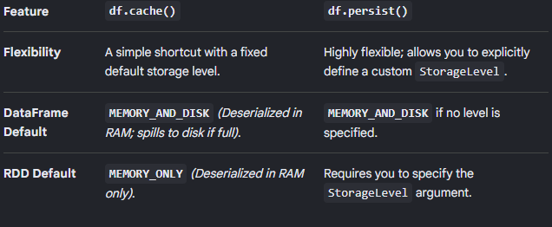
The Difference Between cache() and persist()
While both mechanisms achieve the same goal, the core difference lies in flexibility and customization:

Slide 10
Spark Storage Levels
When using .persist(), you can fine-tune your resource consumption using several Storage Levels:
MEMORY_ONLY: Stores data as deserialized Java objects in memory. If a partition does not fit, it isn't cached and gets recomputed on the fly when needed.
MEMORY_ONLY_SER: Stores data as serialized Java objects (one byte array per partition). This is much more space-efficient than deserialized data but adds CPU overhead to serialize/deserialize.
MEMORY_AND_DISK: Stores data in memory as deserialized objects. If data does not fit, the extra partitions spill over to the local disk.
MEMORY_AND_DISK_SER: Works like MEMORY_ONLY_SER, but spills extra data onto the disk instead of dropping it
DISK_ONLY: Saves all cached data only on the local disk.
OFF_HEAP: Keeps data in off-heap memory (outside the regular JVM heap), which reduces garbage collection overhead

Slide 11
Shuffle operations in spark
It is a shuffle operation is the process of redistributing and reorganizing data across different partitions and cluster nodes so that records with the same keys are physically grouped together.
Shuffling is triggered by wide transformations (where the data needed to compute a single result lives in multiple partitions across the cluster).
Because it forces data to travel over the network and write to local disks, shuffling is the #1 performance bottleneck in most Spark applications.
The data moving from one partition to the other partition process in order to mat up, aggregate, join, or spread out in other ways is called a shuffle.

Slide 12
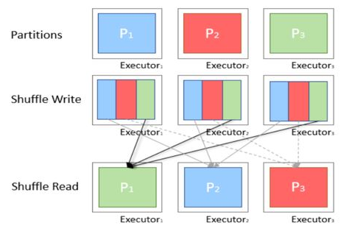
How Spark Architecture Shuffle Works

Slide 13
More to study in shuffle operations
https://www.educba.com/spark-shuffle/

Slide 14
Causes
"Causes" usually refers to either the root causes of performance bottlenecks/failures or how errors propagate across the execution hierarchy.
Primary Causes of Spark Job Failures & Performance Bottlenecks:
  Out of Memory (OOM) Errors
  High Data Shuffling
  Data Skew
  Executor Lost / Container Killed

Slide 15
Memory management in spark
Apache Spark manages executor memory using a Unified Memory Manager that divides the Java Virtual Machine (JVM) heap into distinct, dynamic regions.
Executor Memory Breakdown:

Slide 16
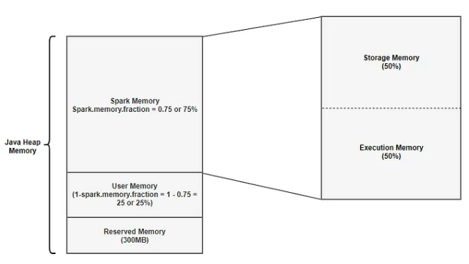

Slide 17
Executor memory breakdown
Reserved Memory
  This is the memory reserved by the system, and its size is hardcoded.
  This memory stores sparks internal objects.
  One thing to note is that, if the executor memory is less than 1.5 times of reserved memory, Spark will fail with a “please use larger heap size” error message.

Slide 18
Executor memory breakdown
User Memory
  This is the memory area that stores all the user defined data structures, any User defined functions created by the user etc,
  The size of this memory pool can be calculated as (Java Heap — Reserved Memory) * (1.0 — spark.memory.fraction).
  Formula : User Memory = (Java Heap — Reserved Memory) * (1.0 — spark.memory.fraction)

Slide 19
Executor memory breakdown
Spark Memory
  This memory pool is managed by Spark.
  This is responsible for storing intermediate state while doing task execution like joins or to store the broadcast variables.
  All the cached/persisted data will be stored in this segment, specifically in the storage memory of this segment.
  Formula : (Java Heap — Reserved Memory) * spark.memory.fraction

Slide 20
Executor memory breakdown
Storage Memory
  Storage memory is used for storing all of the cached data, broadcast variables are also stored here.
  Any persist option which includes MEMORY in it, spark will store that data in this segment.
  park clears space for new cache requests by removing old cached objects based on Least Recently Used (LRU) mechanism.
  Once the cached data it is out of storage, it is either written to disk or recomputed based on configuration.
  Broadcast variables are stored in this segment with MEMORY_AND_DISK persistent level.
  Formula: Storage Memory = (Java Heap — Reserved Memory) * spark.memory.fraction * spark.memory.storageFraction

Slide 21
Executor memory breakdown
Execution Memory
  This memory region is used by Spark for objects created during execution of a task.
  For example,it is used to store hash table for hash aggregation step, it is used to store shuffle intermediate buffer on the Map side in memory etc,.
  This pool also supports spilling on disk if not enough memory is available, but the blocks from this pool cannot be forcefully evicted by other tasks.
  Formula: Execution Memory = (Java Heap — Reserved Memory) * spark.memory.fraction * (1.0 — spark.memory.storageFraction)

Slide 22
More to study in Executor memory breakdown
https://medium.com/analytics-vidhya/apache-spark-memory-management-49682ded3d42

Slide 23
Broadcast variables
Broadcast variables in Apache Spark are read-only shared variables that are cached locally on each worker node (executor) in a cluster rather than being shipped repeatedly alongside individual tasks.
Normally, when a variable is used within a Spark transformation.
Spark serializes and sends a fresh copy of that data to every single task.
If you have 1,000 tasks running across 10 executors, the data is transferred over the network 1,000 times.
With a broadcast variable, Spark sends the data only once per executor, saving massive amounts of network bandwidth, reducing serialization time, and memory overhead.

Slide 24
Introduction to MLlib
MLlib is a machine learning framework built on top of Apache Spark.
It is designed to make machine learning tasks faster and more efficient.
MLlib supports various ML algorithms and utilities.

Slide 25
Core Features of MLlib
MLlib is a scalable, easy to use and comprehensive library
Algorithms like Classification, Regression, Clustering, Collaborative Filtering, etc can be implemented using it.
Similar to scikit-learn hence streamlines the process of building and tuning machine learning workflows.
Includes feature selection, extraction, scaling, etc.

Slide 26
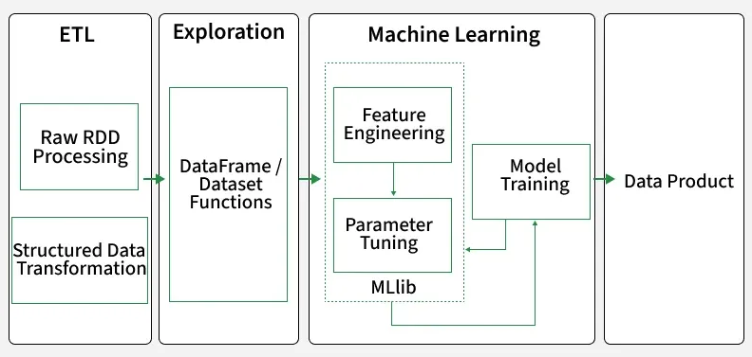
Workflow of MLlib Models

Slide 27
Real-World Use Case
Predictive analytics of diseases based on patient data.
Spam detection and sentiment analysis.
Fraud detection in the finance sector.
Real-time product recommendation in e-commerce.

Slide 28
Basic pipeline
In Apache Spark, a data pipeline follows the classic ETL (Extract, Transform, Load) architecture.
Spark is designed to distribute these operations across a cluster to handle large-scale data seamlessly.
The 3 Core Stages of a Spark Pipeline:
  Extract (Ingestion)
  Transform (Processing)
  Load (Storage)

Slide 29
Integration with external systems
Apache Spark integrates with external systems like databases, cloud storage, and messaging queues using built-in or custom connectors via the Spark Data Source API.
Common External Systems
  Relational Databases (RDBMS)
  Cloud Object Storage
  NoSQL & Warehouses
  Streaming Platforms

Slide 30
How Integration Works
Data Source API
Connectors & Drivers
Query Pushdown

